Slide 1
Function call
Recursion

Slide 2
Functions …
Any C program contains at least one function, i.e., main()
There can only be one main() in a program
There is no limits on number of functions in a program
Functions are called in the sequence specified by function calls in main()
One function can ‘call’ another function

Slide 3
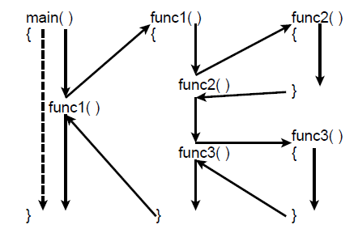
Funcion Call
When compiler encounters a function call, it suspends the current function, and goes on to execute the called function.
After executing the called function, the compiler goes back to the point,
where it left

Slide 4
Function call from function …
main( )
{
cout<< "\nI am in main";
italy( ) ;
cout<<“\nI am finally back in main";
}
void italy( )
{
cout<<"\nI am in italy";
brazil( );
cout<< "\nI am back in italy";
}
void brazil( )
{
cout<< "\nI am in brazil" ;
argentina( ) ;
}
void argentina( )
{
cout<<"\nI am in argentina";
}

Slide 5
Recursion

Slide 6
Recursion
A function calling itself within its body
  Process of solving a problem by reducing it to smaller versions of itself
func()
{
.. . .
func()
.. ..
}

Slide 7
Recursion
Lets take an example to explain recursion
  Computing factiorial
  1! = 1
  n! = n * (n-1)! for all n >1
Limiting Condition
int fact( int n ) {
int result = 1;
for(int i=n; i >0; i- - )
result *=i
return result ;
}
int fact( int n ) {
if ( n == 1 )
return 1;
return n * fact( n-1 );
}

Slide 8
Example
int fact( int 1) {
if ( 1 == 1 )
return 1;
return n * fact( n-1 ); }
1
n
?
ret
int fact( int 2) {
if ( n == 1 )
return 1;
return 2 * fact( 2-1 ); }
2
n
?
ret
int fact( int 3) {
if ( n == 1 )
return 1;
return 3* fact( 3-1 ); }
3
n
?
ret
int fact( int 4 ) {
if ( n == 1 )
return 1;
return 4 * fact( 4-1 ); }
4
n
?
ret
?
k
int k = fact( 4 );

Slide 9
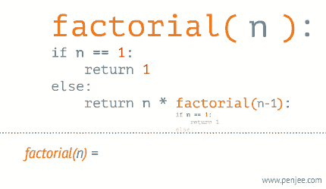

Slide 10
Computing Power using Recursion
  Consider the functions for taking the second, third and fourth powers of a given Float:
  -- 2nd power function
  square x = x*x
  -- 3rd power function
  cube x = x*x*x
Notes:
* Give me some examples
* How many? (more than…)

Slide 11
Recursion
  x⁴ = x*x*x*x = x*( x*x*x ) = x*x³
  x⁵ = x*x*x*x*x = x*(x*x*x*x ) = x*x⁴
  x⁶ = x*x*x*x*x*x = x*(x*x*x*x*x ) = x*x⁵
  In general
  x^{n} = x*x^{n-1}
Notes:
* Give me some examples
* How many? (more than…)

Slide 12
Example: Evaluating Exponents Recurisivley
int power(int k, int n) {
// raise k to the power n
if (n == 0)
return 1;
else
return k * power(k, n – 1);
}
20-<number>

Slide 13
Fibonacci Number
Sequence: 0, 1, 1, 2, 3, 5, 8, 13, 21, 34 . . .
Given first two numbers (a₁ and a₂)
  nth number a_{n}, n >= 3, given by: a_{n} = a_{n-1} + a_{n-2}
Returns the nth Fibonacci number in the sequence
Data Structures Using C++ 2E

Slide 14
